Slide 1


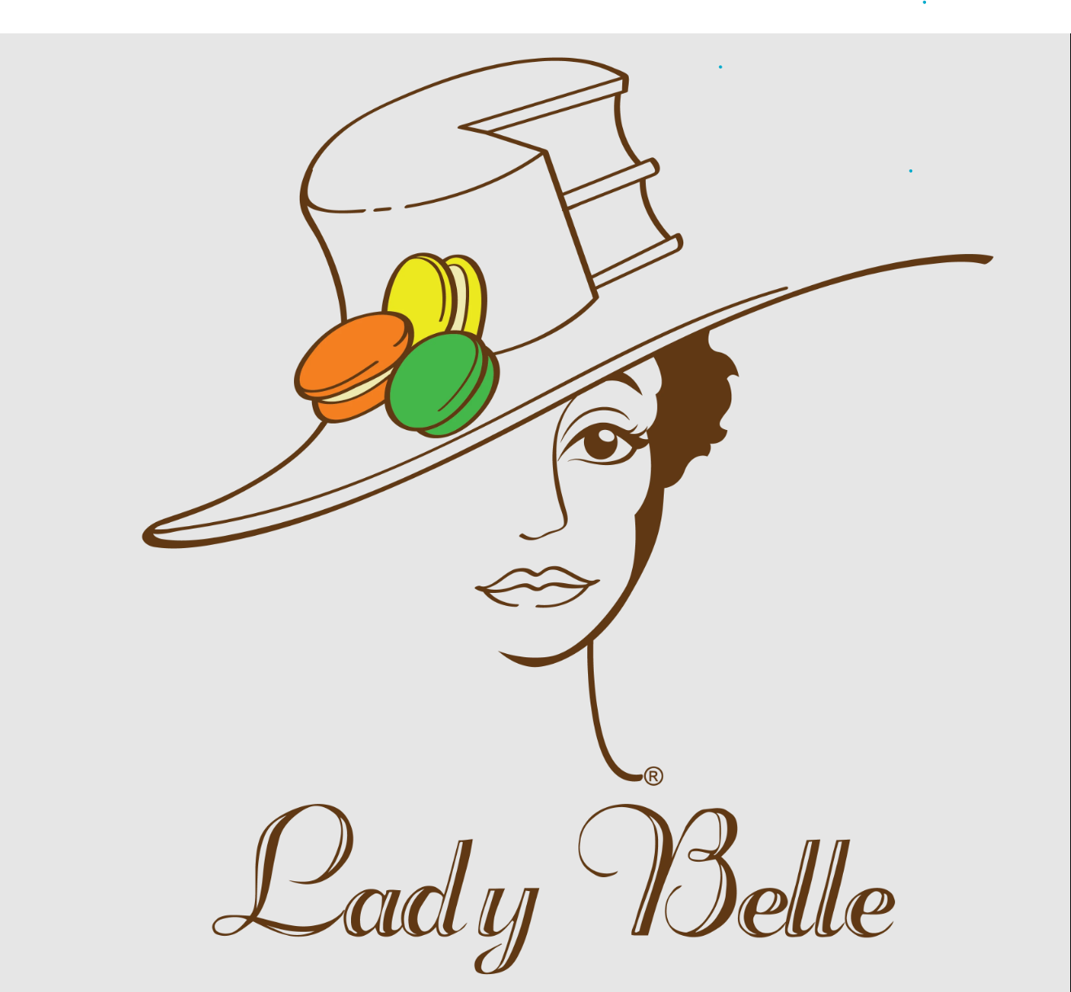

Lady Belle Inventory
Coding by John Sylvester
Inventory made simple between Shopify and Python

